Slide 1
Data Mining
COMP323 Chapter 5

Slide 2
Data Mining works with Warehouse Data
Data Warehousing provides the Enterprise with a memory
Data Mining provides the Enterprise with intelligence

Slide 3

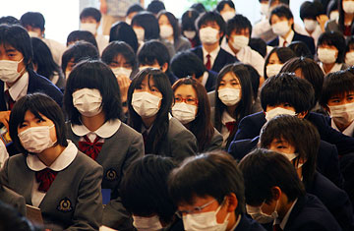
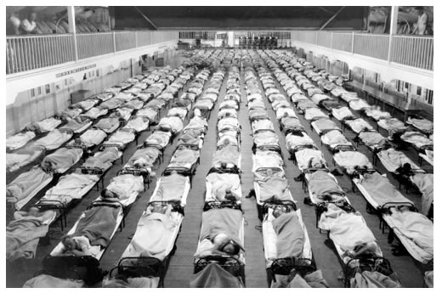
Big Data in Public Health (1)
Flu deaths worldwide per year: 250,000 – 500,000
A new flu virus could cause millions of deaths
Early detection and quick response can reduce the impact of flu
However…the pandemic picture was always a week or two OUT OF DATE
With a rapidly spreading disease, a two-week lag is an eternity
Notes:
http://coldflu.about.com/od/flu/qt/fludeathsperyear.htm

Slide 4
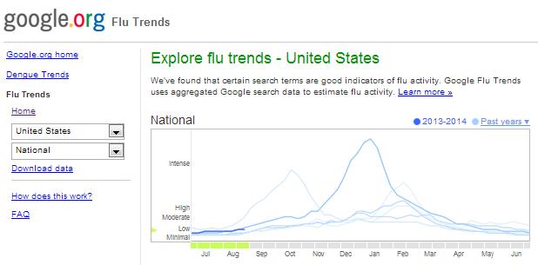
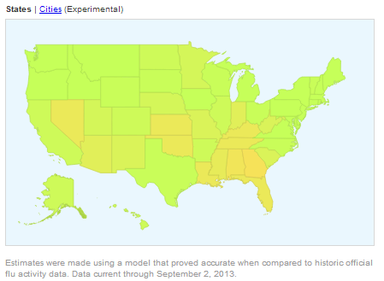
Big Data in Public Health (2)
Google flu trends
Basic idea
Identify areas infected by the flu virus by what people searched for on the internet
Real-time flu estimation
CDC’s estimation always have two weeks’ delay
Nearly as accurate as CDC’s estimation
Notes:
http://www.google.org/flutrends/about/how.html
Paper: Detecting influenza epidemics using search engine query data
By aggregating historical logs of online web search queries
submitted between 2003 and 2008, we computed time series
of weekly counts for 50 million of the most common search
queries in the United States. Separate aggregate weekly
counts were kept for every query in each state.
45 combined search term

Slide 5
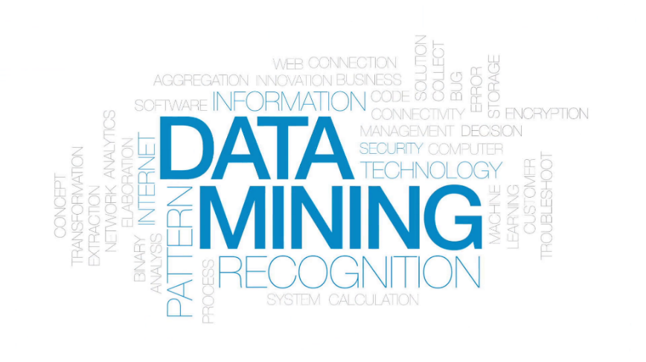
Introduction to Data Mining
Data mining is a process with well-understood stages based on
application of information technology
analyst's creativity
business knowledge
common sense
We look at typical tasks and examples, then at the process

Slide 6

From Business Problems to Data Mining
Decompose a data analytics problem into pieces such that you can solve a known task with a tool
There is a large number of data mining algorithms available, but only a limited number of data mining tasks
We will illustrate the fundamental concepts based on
Association Rule
Classification

Slide 7
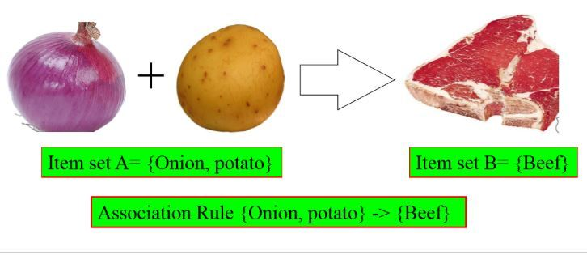
Association Rule
Attempts to find associations between entities based on transactions involving them
Aka association rules or market-basket analysis
E.g., “What items are commonly purchased together?”
Considers similarity of objects based on their appearing together in transactions (compared with clustering)
Included in recommendation systems (people who bought X also bought Y)
Result: a description of items that occur together

Slide 8
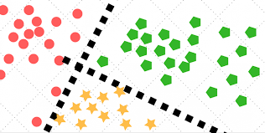
Classification
Classification attempts to predict, for each individual in a population, which of a (small) set of classes that individual belongs to
E.g., “Among all the customers of a cellphone company, which are likely to correspond to a given offer?”
Classification algorithms provide models that determine which class a new individual belongs to
Classification is related to scoring or class probability estimation

Slide 9
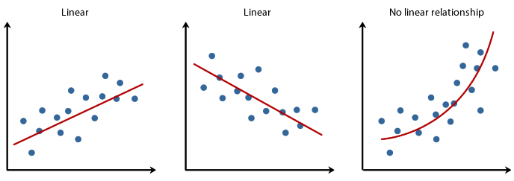
Regression
Regression (value estimation) attempts to estimate or predict, for each individual, the numerical value for that individual
E.g., “How much will a given customer use the service?”
Predicted variable: service usage
Generate regression model by looking at other, similar individuals in the population

Slide 10
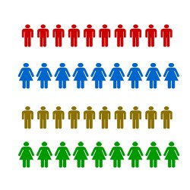
Similarity Matching
Similarity matching attempts to identify similar individuals based on the data known about the individuals
Find similar entities
Basis for making product recommendations
E.g., “Find people who are similar to you in terms of the products they have liked or purchased”
Similarity measures underlie certain solutions to other data mining tasks

Slide 11
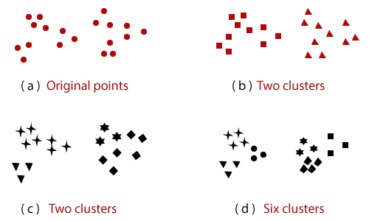
Clustering
Clustering attempts to group individuals in a population together by their similarity, but without regard to any specific purpose
E.g., “Do customers form natural groups or segments?”
Result: groupings of the individuals of a population
Useful in preliminary domain exploration
Four clusters

Slide 12
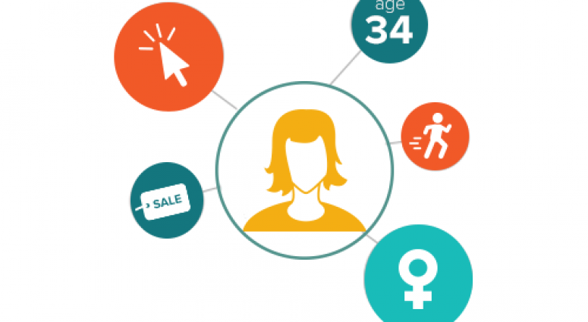
Profiling
Attempts to characterize the typical behavior of a group or population
Aka behavior description
E.g., “What is the typical cellphone usage of this customer segment?”
Often used to establish behavioral norms for anomaly detection (fraud detection)

